Slide 1
TAM: Multi-Touch, Mid-Air, and Motion for Virtual and Augmented Reality – ICAVE – Learning with Virtual Reality
Noel Gonzalez – VIP Junior
Michael Quiros – VIP Junior
Francisco Ortega (mentor)

Slide 2
Project Overview
Purpose is to create a fun and interactive way to implement learning through emerging hardware such as the ICAVE
First iteration of this project, although there has been a previous project utilizing the ICAVE
Aim to teach sailing through a realistic simulation
Takes advantage of the physical interaction with the ICAVE

Slide 3
Project Management

Slide 4
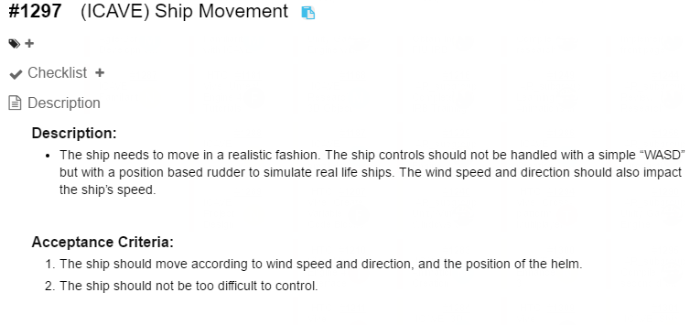
User Stories

Slide 5
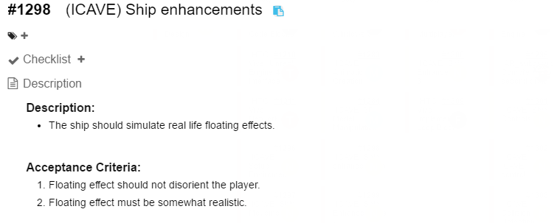
User Stories Continued

Slide 6
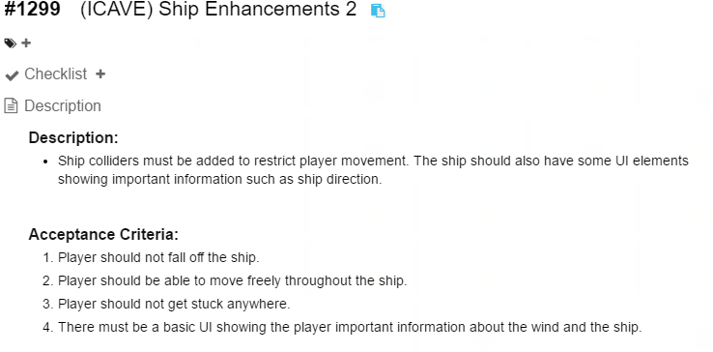
User Stories Continued

Slide 7
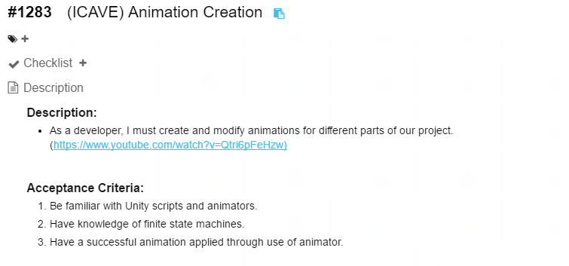
User Stories Continued

Slide 8
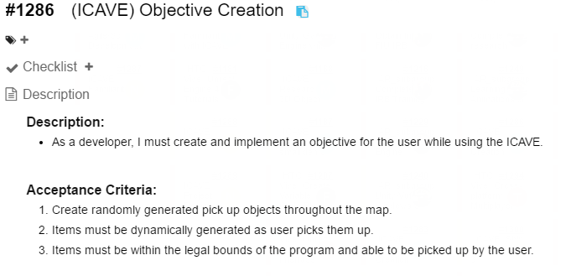
User Stories Continued

Slide 9
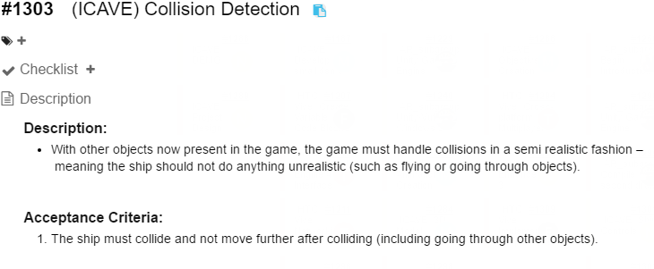
User Stories Continued

Slide 10
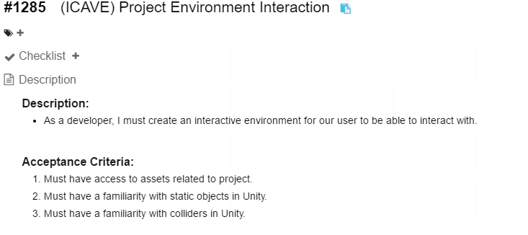
User Stories Continued

Slide 11
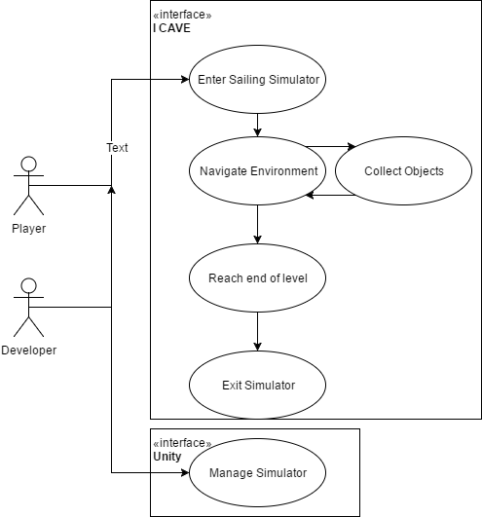
Use Case Diagram

Slide 12
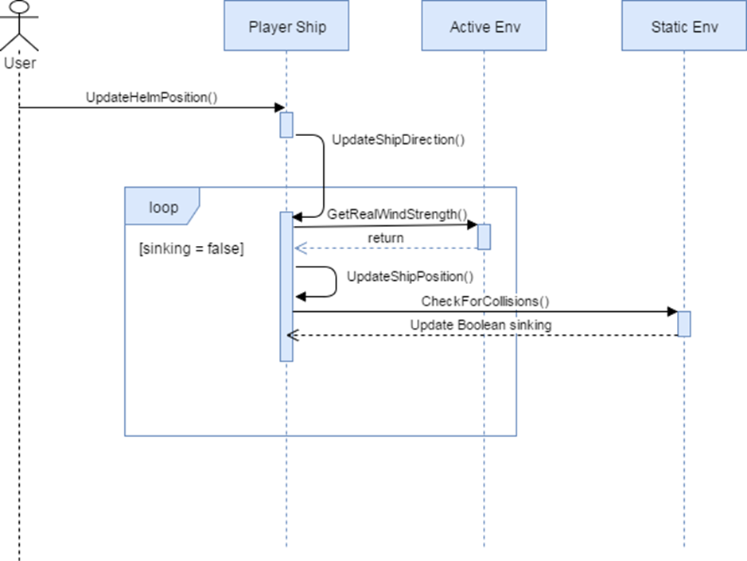
Sequence Diagrams

Slide 13
System Design
Unity’s Component Architecture
Everything on the scene is a GameObject
Scripts are always attached to GameObjects as “behaviors”
Specialized objects do not form subclasses from GameObject but rather apply their effects via the behaviors
Service Oriented Architecture
“Managers” that individually do services and interact with one another
Considered standard in the Unity community

Slide 14
System Deployment
OceanView refers to this project
Devices are all held by the ICAVE
Also requires GetReal3D to run properly

Slide 15
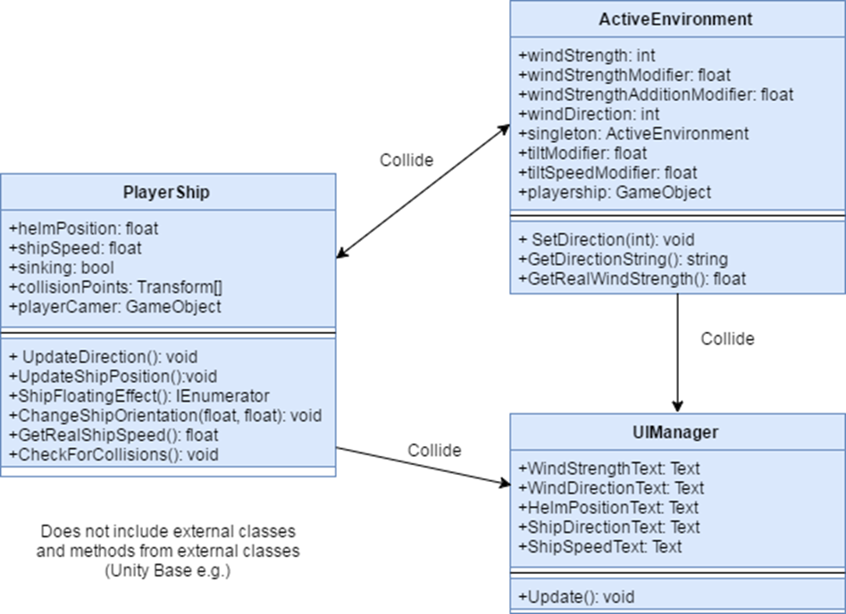
Class Diagram

Slide 16
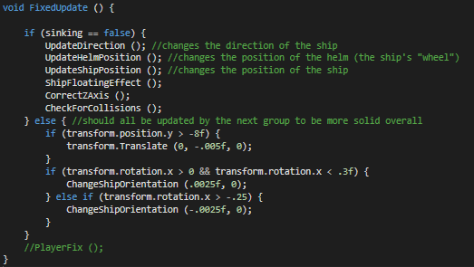
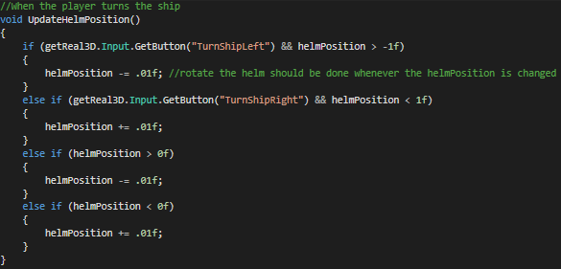
Main Algorithm

Slide 17
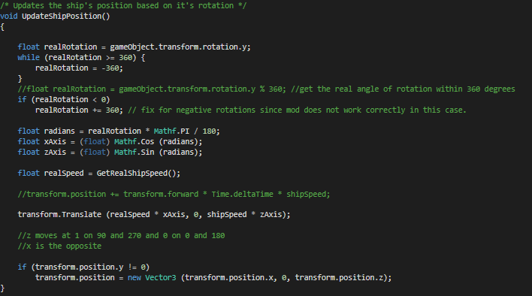
Main algorithm Continued

Slide 18
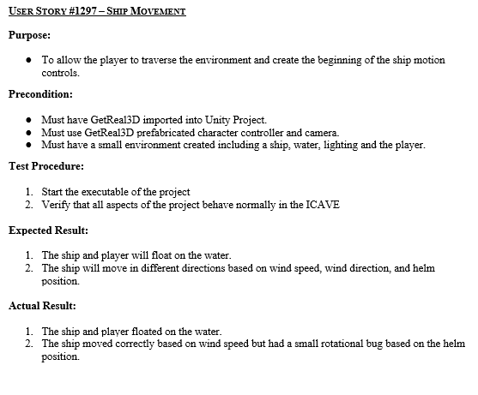
Test Cases

Slide 19
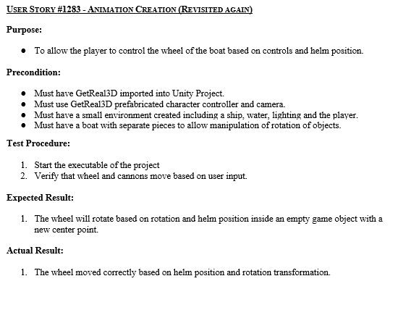
Test Cases Continued

Slide 20
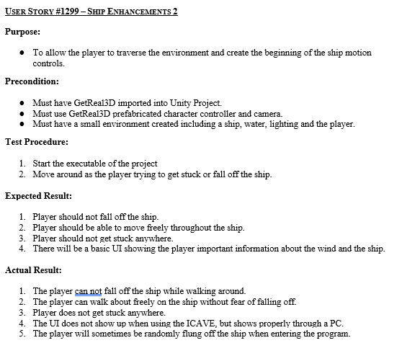
Test Cases Continued

Slide 21
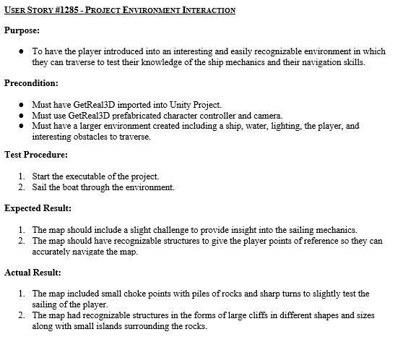
Test Cases Continued

Slide 22
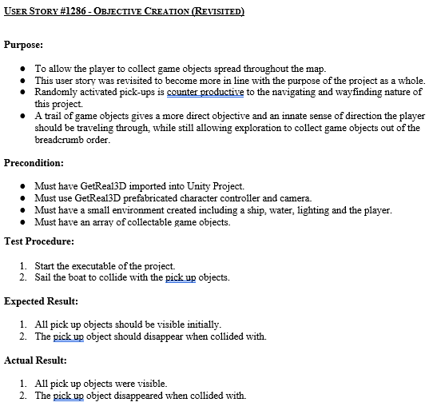
Test Cases Continued

Slide 23
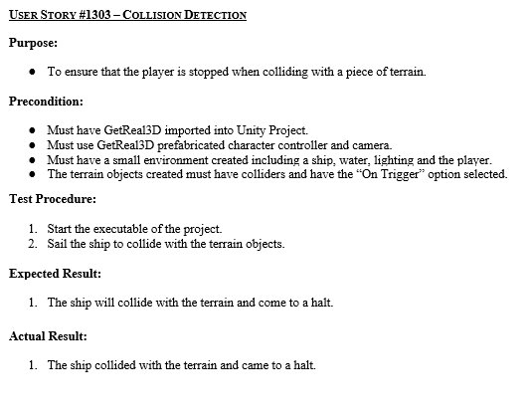
Test Cases Continued

Slide 24
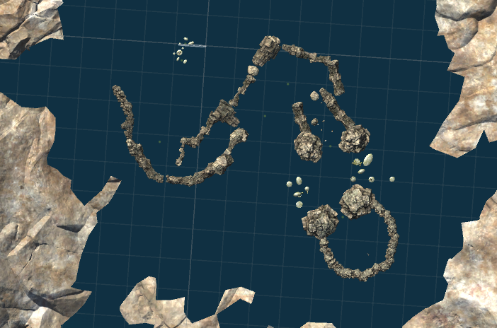
Screenshots

Slide 25
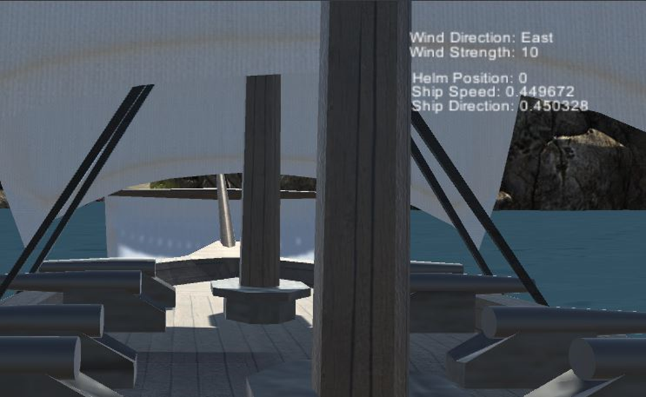
Screenshots

Slide 26
Thank you
The ICave Project Team

